Slide 1
Demand analysis
Topic 4 Part C
Advanced Microeconomics: Theories of Value and Distribution

Slide 2
Demand Functions
The optimal levels of x₁,x₂,…,x_{n}
Can be expressed as functions of all prices and income
These can be expressed as n demand functions of the form:
x₁* = d₁(p₁,p₂,…,p_{n},I)
x₂* = d₂(p₁,p₂,…,p_{n},I)
…
x_{n}* = d_{n}(p₁,p₂,…,p_{n},I)

Slide 3
Demand Functions
For only two goods (x and y):
x* = x(p_{x},p_{y},I)
y* = y(p_{x},p_{y},I)
Prices and income are exogenous
The individual has no control over these parameters

Slide 4
Demand Functions
Homogeneity of demand functions
Double or halve all prices and income - the optimal quantities demanded would remain unchanged
The budget constraint is unchanged
x_{i}* = x_{i}(p₁,p₂,…,p_{n},I) = x_{i}(tp₁,tp₂,…,tp_{n},tI)
Individual demand functions are homogeneous of degree zero in all prices and income
Notes:
In words, a function that is homogenous of degree zero implies that multiplying each of its independent variables will not alter the value of the function.
Demand functions are homogenous of degree zero. (Recall that expenditure functions are homogenous of degree one. Can you see the difference?)
We can see this geometrically also by considering what happens to the budget constraint when prices and income change by the same factor. The vertical and horizontal intercepts will be the same as before. Therefore, the line connecting them will also be the same. This implies that we will end up being tangent to the same indifference curve as before.

Slide 5
5.1 Homogeneity
Cobb-Douglas utility function:
utility = U(x,y) = x^{0.3}y^{0.7}
The demand functions are: x*=0.3I/p_{x} and y*=0.7I/p_{y}
Exhibit homogeneity
CES utility function:
utility = U(x,y) = x^{0.5} + y^{0.5}
The demand functions are:
Exhibit homogeneity
Notes:
Examples demonstrate that homogeneity of demand functions is a result of utility maximization.

Slide 6
Changes in Income
An increase in income
Will push the budget constraint out in a parallel fashion
p_{x}/p_{y} does not change
The MRS at the new equilibrium will be the same as in the previous equilibrium
The individual moves to a higher indifference curve

Slide 7
5.1 Effect of an Increase in Income on the Quantities of x and y Chosen
Quantity of y
I₃
I₂
y₃
y₂
I₁
U₃
y₁
U₂
U₁
x₁
x₂
x₃
Quantity of x
As income increases from I₁ to I₂ to I₃, the optimal (utility-maximizing) choices of x and y are shown by the successively higher points of tangency. Observe that the budget constraint shifts in a parallel way because its slope (given by -p_{x}/p_{y}) does not change.

Slide 8
Changes in Income
Normal good
Consider some range of income
A good x_{i} for which ∂x_{i}/∂I ≥ 0 over that range of income
Inferior good
Consider some range of income
A good x_{i} for which ∂x_{i}/∂I < 0 over that range of income
Notes:
Examples of normal and inferior good: butter vs margarine; new clothing vs used clothing; rotgut booze vs regular booze.

Slide 9
5.2 Inferior Good
Quantity of y
y₃
I₂
U₃
y₂
I₃
I₁
U₂
y₁
U₁
z₃
z₂
z₁
Quantity of z
In this diagram, good z is inferior because the quantity purchased decreases as income increases. Here, y is a normal good (as it must be if there are only two goods available), and purchases of y increase as total expenditures increase.

Slide 10
Changes in a Good’s Price
A change in the price of a good
Alters the slope of the budget constraint
The consumer’s utility-maximizing choices will display different MRS
Two effects come into play
Substitution effect
Income effect

Slide 11
Changes in a Good’s Price
Substitution effect of a price change
Looks at what happens even if the individual were to stay on the same indifference curve
Consumption pattern would change so as to equate the MRS to the new price ratio

Slide 12
Changes in a Good’s Price
Income effect of a price change
Arises because a price change necessarily changes an individual’s ‘‘real’’ income, i.e., their purchasing power over the good that has changed in price
The individual will not stay on the initial indifference curve and will move to a new one

Slide 13
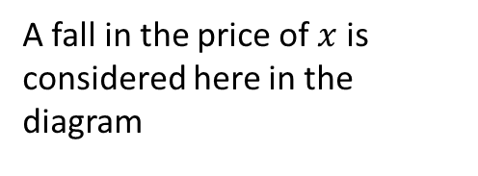
5.3 Income and Substitution Effects
Quantity of y
I/p_{y}
A fall in the price of $x$ is considered here in the diagram
y**
y*
B
U₂
I=p²_{x}x+p_{y}y
U₁
I=p¹_{x}x+p_{y}y
x*
x_{B}
x**
Quantity of x
Substitution effect
Income effect
Total increase in x
Notes:
When the price of $x$ decreases from $p1x$ to $p2x$ , the utility-maximizing choice shifts from x*,y* to x**,y**. This movement can be broken down into two analytically different effects:
The substitution effect involving a movement along the initial indifference curve to point $B$, where the MRS is equal to the new price ratio.
The income effect, entailing a movement to a higher level of utility because real income has increased.
In the diagram, both the substitution and income effects cause more $x$ to be bought when its price decreases. Notice that point $I/py$ is the same as before the price change; this is because $py$ has not changed. Therefore, point $I/py$ appears on both the old and new budget constraints.

Slide 14
Changes in a Good’s Price: Normal good
If a good is normal, substitution and income effects reinforce one another
When p ↓:
Substitution effect ⇒ quantity demanded ↑
Income effect ⇒ quantity demanded ↑
When p ↑:
Substitution effect ⇒ quantity demanded ↓
Income effect ⇒ quantity demanded ↓
Notes:
Recall that for a normal good, the change in income and in quantity demanded is in the same direction

Slide 15
Changes in a Good’s Price: Inferior good
If a good is inferior, substitution and income effects move in opposite directions
When p ↓:
Substitution effect ⇒ quantity demanded ↑
Income effect ⇒ quantity demanded ↓
When p ↑:
Substitution effect ⇒ quantity demanded ↓
Income effect ⇒ quantity demanded ↑
Notes:
Recall that for an inferior good, the change in income and quantity demanded is in the opposite direction. Substitution effect work in the same direction as in the case of a normal good.

Slide 16
Changes in a Good’s Price: Giffen good
Giffen’s paradox of inferior goods
If the income effect of a price change is strong enough, there could be a positive relationship between price and quantity demanded
An increase in price leads to a drop in real income
Since the good is inferior, a drop in income causes quantity demanded to rise
For inferior goods, no definite prediction can be made for changes in price

Slide 17
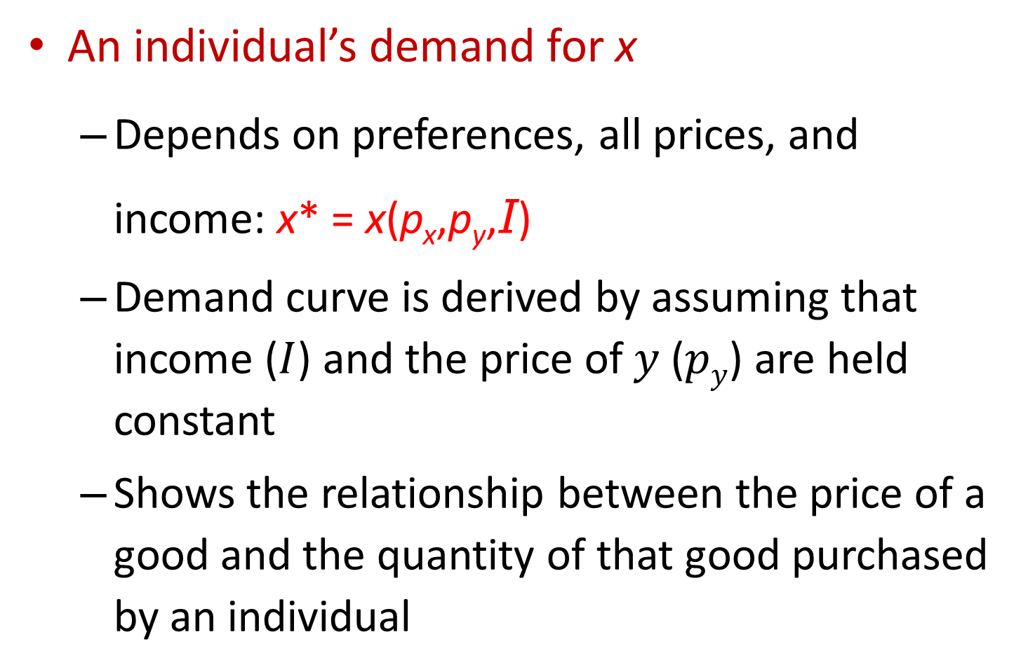
The Individual’s Demand Curve
An individual’s demand for x
Depends on preferences, all prices, and income: x* = x(p_{x},p_{y},I)
Demand curve is derived by assuming that income ($I$) and the price of $y$ ($py$) are held constant
Shows the relationship between the price of a good and the quantity of that good purchased by an individual

Slide 18
5.5 Construction of an Individual’s Demand Curve
Quantity of y
p_{x}
I / p_{y}
I = p_{x}’’’x + p_{y}y
p_{x}’
p_{x}’’
p_{x}’’’
U₃
x
U₁
U₂
x’
x”
x”’
Quantity of x
x’
x’’
x’’’
Quantity of x
I = p_{x}’x + p_{y}y
I = p_{x}’’x + p_{y}y
Panel A
Panel B
Notes:
In (A), the individual’s utility-maximizing choices of $x$ and $y$ are shown for three different prices of x(p’_{x}, p”_{x}, and p’”_{x}). In (B), this relationship between p_{x} and x is used to construct the demand curve for x. The demand curve is drawn on the assumption that p_{y}, I, and preferences remain constant as p_{x} varies.

Slide 19
Shifts in the demand curve
Three factors are held constant when a demand curve is derived
Income
Prices of other goods (p_{y})
The individual’s preferences
If any of these factors change, the demand curve will shift to a new position

Slide 20
Quantity demanded vs. Demand
A change in quantity demanded
Movement along a given demand curve
Caused by a change in the price of the good
A change in demand
Shift in the demand curve
Caused by changes in income, prices of other goods, or preferences

Slide 21
Compensated (HICKSIAN) Demand Curves and Functions
Actual level of utility
Varies along the demand curve
As the price of x falls, the individual moves to higher indifference curves (i.e. higher utility)
Assumption: nominal income is held constant as the demand curve is derived
“Real” income rises as the price of x falls
Notes:
We can also see the reasoning here graphically. For example, if we plot the quantity demanded of $x$ on the horizontal axis, the point where the budget line cuts the horizontal axis is given by $I/p_{x}$. A fall in $p_{x}$ is equivalent to a rise in the purchasing power over $x$, a rise in real income.

Slide 22
Compensated (HICKSIAN) Demand Curves and Functions
Alternative approach
Hold real income (or utility) constant while examining reactions to changes in p_{x}
The effects of the price change are “compensated” so as to force the individual to remain on the same indifference curve
Reactions to price changes include only substitution effects

Slide 23
Compensated (HICKSIAN) Demand Curves and Functions
Compensated (Hicksian) demand curve
Shows the relationship between the price of a good and the quantity purchased
Assuming that other prices and utility are held constant
Is a two-dimensional representation of the compensated demand function
x* = x^{c}(p_{x},p_{y},U)

Slide 24
5.6 Construction of a Compensated Demand Curve
Quantity of y
p_{x}
U₂
Slope = p’_{x}/p_{y}
Slope = p”_{x}/p_{y}
p_{x}’
Slope = p”’_{x}/p_{y}
p_{x}’’
p_{x}’’’
x^{c}
x’
x”
x”’
Quantity of x
x’
x’’
x’’’
Quantity of x
The curve x^{c} shows how the quantity of x demanded changes when p_{x} changes, holding p_{y} and utility constant. That is, the individual’s income is ‘‘compensated’’ to keep utility constant. Hence x^{c} reflects only substitution effects of changing prices.

Slide 25
Compensated (HICKSIAN) Demand Curves and Functions
Shephard’s lemma
Compensated demand function for a good
Can always be found from the expenditure function by differentiation with respect to good’s price
Lagrangian: ℒ =p_{x}x+p_{y}y+λ[U(x,y)-Ū]
Yields the expenditure function: E(p_{x},p_{y},U)
Envelope theorem:
Notes:
The proposition that the first derivative of the expenditure function with respect to a commodity’s price is the compensated demand function for that commodity is an application of the so-called Shephard’s Lemma (see section 5.5.1 of the text). This Lemma, in turn, is an application of the envelope theorem. Let’s look at this theorem briefly.
Suppose that $\left.f(x,a\right)$ is a function of both $x$ and $a$. We consider $a$ as a parameter that is given exogenously (like the prices in the expenditure function) and $x$ as the variable of interest (like the quantitates demanded in the expenditure function). Suppose that $x$ is chosen to minimize the function. For each value of $a$, there will be a different optimal value of $x$. This allows us to define the (optimal) value function, $M\left(a\right)=f\left(x\left(a\right),a\right)$. This function tells us what the optimized value of $f$is for different values of $a$. For a given value of $a$, this equation is an identity, i.e.,
$$M\left(a\right)≡f\left(x\left(a\right),a\right)$$
Differentiating (using the chain rule) both sides of this identity gives:
$$\frac{dM\left(a\right)}{da}≡\frac{∂f\left(x\left(a\right),a\right)}{∂x}\frac{∂x}{∂a}+\frac{∂f\left(x\left(a\right),a\right)}{∂a}$$
Since $x\left(a\right)$ is the choice of $x$ that minimizes $f$, we know that
$$\frac{∂f\left(x\left(a\right),a\right)}{∂x}=0$$
Substituting this into the above expression we get:
$$\frac{dM\left(a\right)}{da}=\frac{∂f\left(x\left(a\right),a\right)}{∂a}$$
Or a better way to write this is:
$${\frac{dM\left(a\right)}{da}=\frac{∂f\left(x,a\right)}{∂a}|}_{\left.x=x(a\right)}$$
In this expression , it is clear that the derivative is taken holding $x$ at the optimal value $x\left(a\right)$.
In words, the total derivative of the value function with respect to the parameter is equal to the partial derivative when the derivative is evaluated at the optimal choice. In our case here, the value function is the expenditure function, the parameter is price, and $x$ is quantity demanded.

Slide 26
Compensated (HICKSIAN) Demand Curves and Functions
Relationship between compensated and uncompensated demand curves
Normal good
Compensated demand curve is less responsive to price changes than is the uncompensated demand curve
Uncompensated demand curve reflects both income and substitution effects
Compensated demand curve reflects only substitution effects

Slide 27
5.7 Comparison of Compensated and Uncompensated Demand Curves
p_{x}
p_{x}’
p_{x}’’
p_{x}’’’
x(p_{x},p_{y},I)
x^{c}(p_{x},p_{y},U)
x’
x*
x’’
x**
x’’’
Quantity of x
Notes:
This figure should be examined in conjunction with the Marshallian demand curve (Figure 5.6, slide 19). The standard demand curve (dark blue) is more price-responsive than the Marshallian demand curve (red) because it incorporates both substitution and income effects, whereas the curve x^{c} reflects only substitution effects.
The compensated (x^{c}) and uncompensated (x) demand curves intersect at p”_{x} because x” is demanded under each concept. For prices above p”_{x}, the individual’s purchasing power must be increased with the compensated demand curve; thus, more x is demanded than with the uncompensated curve. For prices below p”_{x}, purchasing power must be reduced for the compensated curve; therefore, less x is demanded than with the uncompensated curve.

Slide 28
5.3 Compensated Demand Functions
The utility function is: utility = U(x,y) = x^{0.5}y^{0.5}
The Marshallian demand functions:
x(p_{x},p_{y},I) = 0.5I/p_{x} and y(p_{x},p_{y},I) = 0.5I/p_{y}
The expenditure function: E(p_{x},p_{y}, U)=2p_{x}^{0.5}p_{y}^{0.5}U
Use Shephard’s lemma to calculate the compensated demand functions as

Slide 29
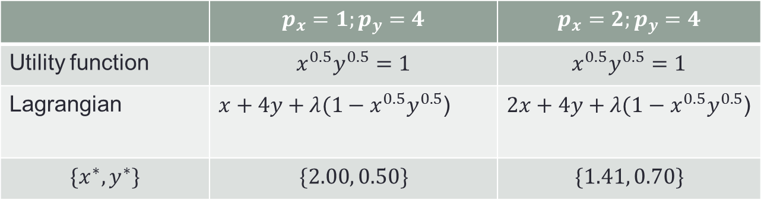
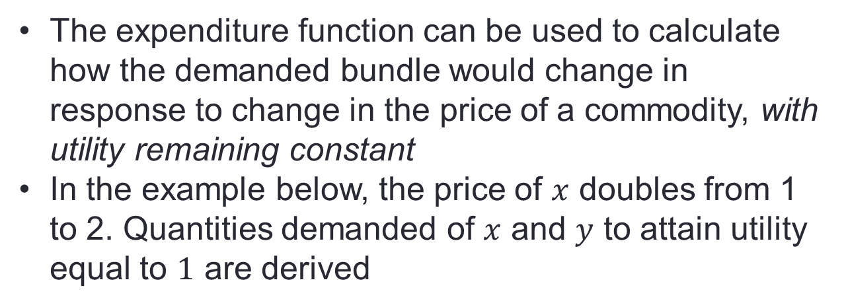
Expenditure function: example
The expenditure function can be used to calculate how the demanded bundle would change in response to change in the price of a commodity, with utility remaining constant
In the example below, the price of $x$ doubles from 1 to 2. Quantities demanded of $x$ and $y$ to attain utility equal to $1$ are derived
 | $$p_{x}=1;p_{y}=4$$ | $$p_{x}=2;p_{y}=4$$
Utility function | $$x^{0.5}y^{0.5}=1$$ | $$x^{0.5}y^{0.5}=1$$
Lagrangian | $x+4y+λ({1−x}^{0.5}y^{0.5}$) | $2x+4y+λ({1−x}^{0.5}y^{0.5}$)
$$\{x^{∗},y^{∗}\}$$ | $$\{2.00, 0.50\}$$ | $$\{1.41, 0.70\}$$
Notes:
Dual: Minimize expenditure
Mathematica code to derive the solution when $p_{x}=1$:
L= x+4 y+lambda*(2-x^{0.5} y^{0.5})
D[L,x]
D[L,y]
D[L,lambda]
Solve[{D[L,x]==0,D[L,y]==0,D[L,lamba]==0}]

Slide 30
A Mathematical Development of Response to Price Changes
Use the utility-maximization model
To learn something about how the demand for good x changes when p_{x} changes
Calculate ∂x/∂p_{x}
Direct approach
Comparative static methods by differentiating the three first order conditions for a maximum with respect to p_{x}
Cumbersome and provides little economic insight

Slide 31
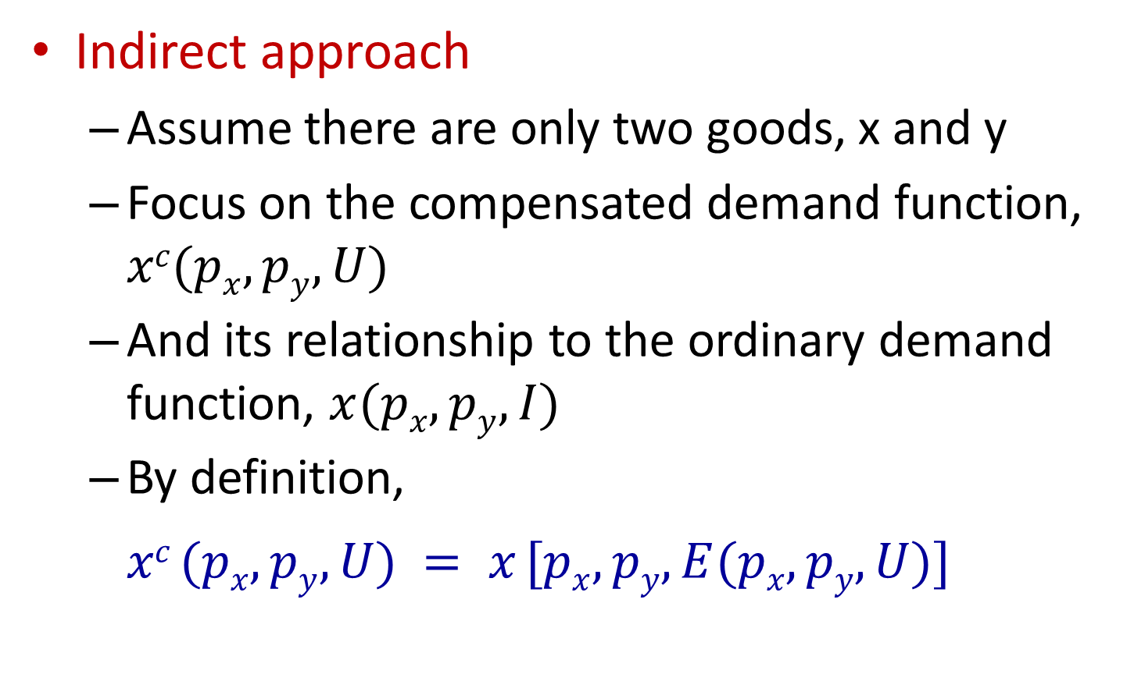
A Mathematical Development of Response to Price Changes
Indirect approach
Assume there are only two goods, x and y
Focus on the compensated demand function, $xc(px,py,U)$
And its relationship to the ordinary demand function, $x(px,py,I)$
By definition,
$$xc (px,py,U) = x [px,py,E(px,py,U)]$$
Notes:
The LHS is the (Hicksian) demand function with a given level of utility, $U.$ The RHS is the (Marshallian) demand function when consumer’s income is just enough to attain that level of utility, $U$. This is why we can replace $I$ with expenditure function in the Marshallian demand function. Recall that the expenditure function is always defined for a given level of utility, i.e., its derived from solving a minimization problem: what is the cheapest way to attain a given level of utility at an exogenously given set of relative prices.
We start our derivation by partially differentiating both sides of the equation with respect to $p_{x}$

Slide 32
A Mathematical Development of Response to Price Changes
Indirect approach
The substitution effect
The first term: the slope of the compensated demand curve
The income effect
The second term: measures the way in which changes in p_{x} affect the demand for x through changes in purchasing power
Notes:
Note that $p_{i}$ enters into the Marshallian demand function in two places: first via its direct effect on quantity demanded; second, via its indirect effect on expenditure.
The LHS shows how quantity demand changes when price changes
The RHS says that the change in quantity demanded is equal to:
The change in compensated demand (substitution effect) plus
The change in quantity demanded via changes in the necessary expenditure levels---this is the income effect. The negative sign shows the direction of this effect. To elaborate:
Suppose that $p_{i}$ increases. Then, expenditures will have to increase to keep utility constant: $\frac{∂E}{∂p_{i}}>0$. But, because nominal income is assumed to be fixed, expenditures cannot go up. Therefore the quantity demanded of $x_{i}$ has to decline to meet this shortfall in available income. The extent of the decline is shown by $\frac{∂x_{i}}{∂E}$.
Suppose that $p_{i}$ decreases. Then, expenditures required to keep utility constant will decline: $\frac{∂E}{∂p_{i}}<0$. . But, because nominal income is assumed to be fixed, purchasing power over $x_{i}$ goes up. Therefore the quantity demanded of $x_{i}$ will increase. The extent of the increase is shown by $\frac{∂x_{i}}{∂E}$.

Slide 33
A Mathematical Development of Response to Price Changes
The Slutsky equation
Notes:
We can replace $x^{c}$ with $x$ in the final equation because for a given utility-maximizing equilibrium, the Hicksian and Marshallian demands coincide.

Slide 34
A Mathematical Development of Response to Price Changes
The Slutsky equation
The substitution effect
Always negative as long as MRS is diminishing
The slope of the compensated demand curve must be negative
The income effect
If x is a normal good, then ∂x/∂I > 0
The entire income effect is negative
If x is an inferior good, then ∂x/∂I < 0
The entire income effect is positive

Slide 35
Marshallian Demand Elasticities
Marshallian demand elasticities
Marshallian demand function: x(p_{x},p_{y},I)
1. Price elasticity of demand, e_{x}, _{px}
Measures the proportionate change in quantity demanded in response to a proportionate change in a good’s own price
Notes:
The concept of elasticity is more useful than the derivative in practical applications. We can compare elasticities across commodities because they are percentage changes; but, we can’t compare derivatives across commodities because they are usually expressed in different units (e.g. quantity demanded of beer goes up by a pint when price drops by $1, while the quantity demanded of bread goes up by one loaf when price drops by $1).
Pay attention to the notation of elasticities. The first subscript shows the commodity for which we are defining the elasticity; the second indicates the variable with respect to which variable we are computing the elasticity.

Slide 36
Marshallian Demand Elasticities
2. Income elasticity of demand, e_{x,I}
Measures the proportionate change in quantity demanded in response to a proportionate change in income

Slide 37
Marshallian Demand Elasticities
3. Cross-price elasticity of demand, e_{x,py}
Measures the proportionate change in quantity of x demanded in response to a proportionate change in the price of some other good (y)

Slide 38
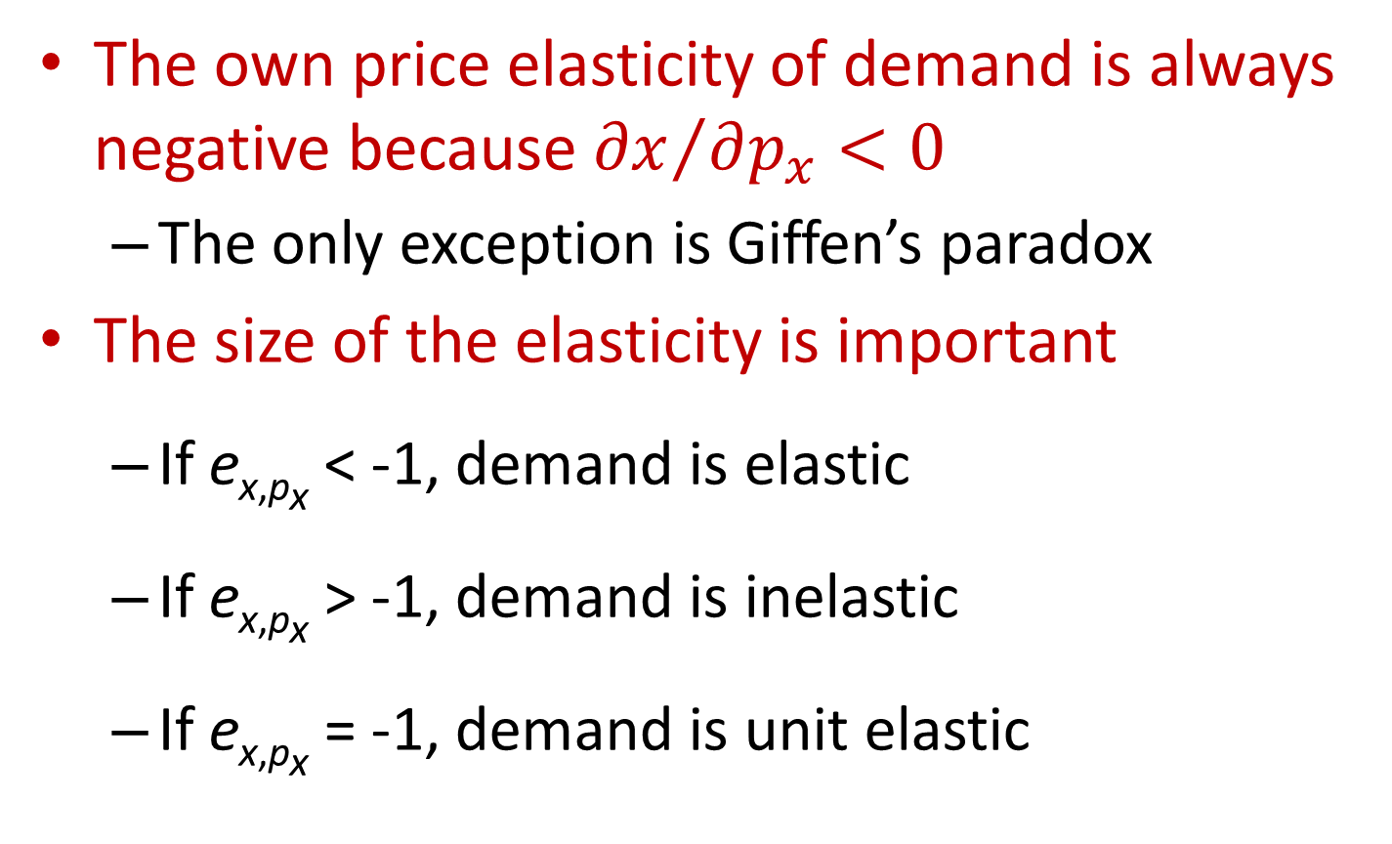
Price elasticity of demand
The own price elasticity of demand is always negative because ${∂x}/{∂p_{x}<0}$
The only exception is Giffen’s paradox
The size of the elasticity is important
If e_{x,px} < -1, demand is elastic
If e_{x,px} > -1, demand is inelastic
If e_{x,px} = -1, demand is unit elastic
Notes:
The partition between elastic and inelastic is set at -1 when the proportionate changes in price and quantity are equal.
Elastic demand: proportionate change in the quantity demanded is greater than the proportionate change in price (e.g. elasticity of -4).
Inelastic demand: proportionate change in the quantity demanded is smaller than the proportionate change in price (e.g. elasticity of -0.2).

Slide 39
Price Elasticity of Demand
Total spending on x = p_{x}x
If 0 > e_{x,px} > -1, demand is inelastic
Price and total spending move in the same direction
If e_{x,px} < -1, demand is elastic
Price and total spending move in opposite directions
Notes:
The relation shown by the equation is derived via calculus using the product rule of differentiation.
The sign of the derivative on the LHS depends on whether the price elasticity is larger or smaller than -1. Suppose that it is -2 (elastic demand). Then, for an increase in price, total spending will go down. On the other hand suppose that the elasticity is -0.5 (inelastic demand). Then, an increase in price will produce an increase in spending.

Slide 40
Compensated Price Elasticities
Compensated price elasticities
Compensated demand function, x^{c}(p_{x},p_{y},U)
Compensated own-price elasticity of demand, e_{xc,px}
Measures the proportionate compensated change in quantity demanded in response to a proportionate change in a good’s own price

Slide 41
Compensated Price Elasticities
2. Compensated cross-price elasticity of demand, e_{xc,py}
Measures the proportionate compensated change in quantity of x demanded in response to a proportionate change in the price of another good, y

Slide 42
Compensated Price Elasticities
Notes:
We multiply the Slutsky equation by the factor $p_{x}/x$ to derive the relationship between the uncompensated and compensated price elasticities.
The first expression on the RHS uses the first equation on this slide. The second expression on the slide uses the equation (from slide 39) for the income elasticity of Marshallian demand.
When will price elasticity of demand be equal to the price elasticity of compensated demand? If the commodity takes up only a small portion of the consumer’s budget and/or when its income elasticity is small.

Slide 43
Relationships among Demand Elasticities
Homogeneity
Demand functions are homogeneous of degree zero in all prices and income
Euler’s theorem for homogenous functions shows that

Slide 44
Relationships among Demand Elasticities
Engel aggregation
Engel’s law: income elasticity of demand for food items is <1
Income elasticity of demand for all nonfood items must be >1
Differentiate the budget constraint with respect to income

Slide 45
Relationships among Demand Elasticities
Cournot aggregation
The size of the cross-price effect of a change in p_{x} on the quantity of y consumed is restricted because of the budget constraint
Differentiate the budget constraint with respect to p_{x}

Slide 46
Relationships among Demand Elasticities
Cournot aggregation

Slide 47
Summary
Utility maximization is the foundation of demand functions for products
To derive “well-behaved”, i.e., negatively sloped demand functions that yield unique quantities demanded when the consumer is in equilibrium
The utility function should be
strictly quasi-concave
continuous
Giffen goods are the exception to this construction (i.e., demand function with positive slope)
Not all preference relations need to satisfy all the axioms of choice
Notes:
Strict convexity of indifference curves is ensured by assuming that the utility function is strictly quasi-concave
The assumption of a strictly quasi-concave utility function is equivalent to assuming diminishing MRS everywhere (not just at the optimal point)

